Slide 1
Space Station Activities
By Matthew Katterman

Slide 2
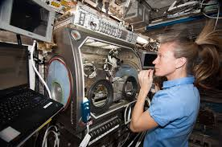
Astronauts work on a Space Station
Astronauts have very busy schedules. They have many tasks.
Conduct experiments, perform maintenance and repairs are some of them.
ISS is primarily a Research Facility.
Conduct body, health, medical experiments.
Some experiments controlled from the Earth.
Astronauts perform most of the experiments.

Slide 3
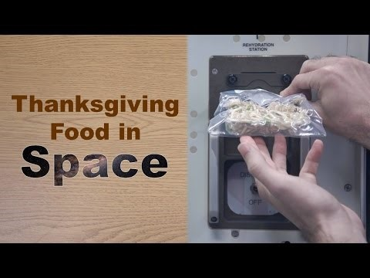
Eating in Space
Astronauts eat three meals a day.
They spend some time preparing their food.
Most of the time they eat from packages that have dehydrated food.
Add heated water to the package and then keep it warm.

Slide 4
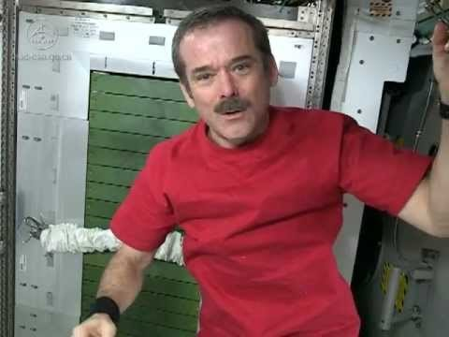
Exercising in Space
Astronauts have to exercise twice a day for at least two hours a day.
Exercising must be done in order to keep bones and muscles healthy.
They have treadmills and weight-lifting equipment for exercise.

Slide 5
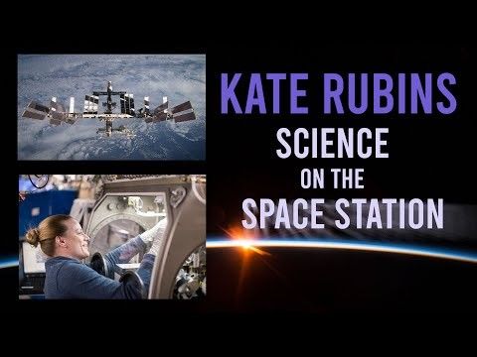
Working in Space
Scientists on Earth plan and make experiments that they cannot do on Earth but can do on the Space Station.
Astronauts are the ones who execute these experiments. That is most of their work in outer space.
They can work on hundreds of experiments while they are on the ISS during their mission.

Slide 6
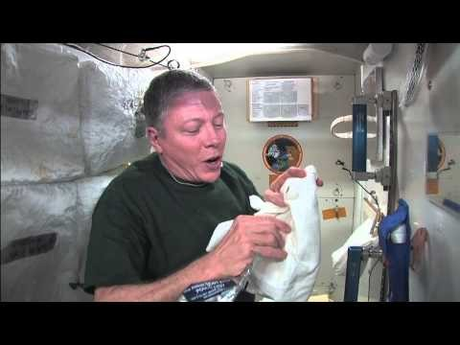
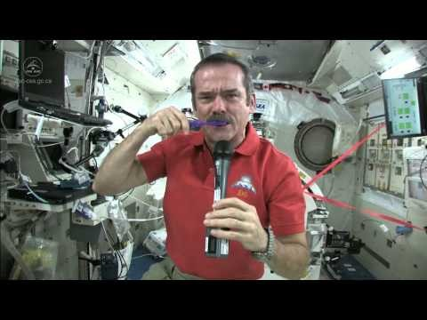
Personal Hygiene in Space
Astronauts in space use very little water while cleaning themselves.
Water cannot come out of a tap or go down a sink.
This presents a challenge on how they conduct hygiene related activities on the space station.
Some activities are washing their hair, brushing their teeth, taking a bath.

Slide 7
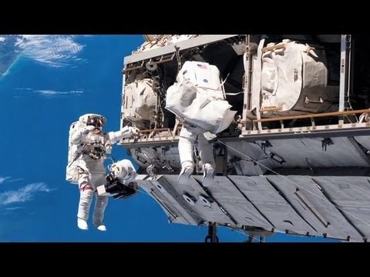
Space Walking
Astronauts often go on Space Walks outside of the ISS to do repairs or maintenance on the spacecraft.
The space suits are called Extravehicular Activities (EVAs)
They can stay for several hours at a time on Space Walks.

